Slide 1

GlassWire: Network Monitoring and Security Analysis
Network Information Security
Group Members:
Anushri Bhaskarwar 16010123055
Siddhant Mane 16010123058
Akshat Kunder 16010123033

Slide 2

Introduction
Applications continuously communicate with remote servers for updates, cloud services, and background operations. Without proper monitoring, users may remain unaware of network usage or suspicious activity.
GlassWire is a graphical network monitoring and security analysis tool that provides real-time visibility into internet activity, application bandwidth usage, remote hosts, and connected devices. It also shows country-wise traffic and alerts for first-time network activity.
In this experiment, GlassWire was installed on a Windows system and features like Traffic Monitor, Log Analysis, Firewall, Network Scanner, and Hardware Resources were explored. The tool identified high bandwidth usage, detected connected devices, and visualized network activity.
GlassWire improves security awareness and provides effective network monitoring and analysis.

Slide 3

Objectives
• To study the working of GlassWire
• To monitor real-time network traffic
• To identify high bandwidth-consuming applications
• To inspect remote hosts and IP addresses
• To observe alerts for first-time network activity
• To understand GlassWire Protect firewall view
• To detect devices connected to local network
• To monitor CPU, memory, disk, and GPU usage
• To evaluate GlassWire for security monitoring

Slide 4
Features of Glasswire
Traffic Monitor Feature
Traffic Monitor provides real-time visibility into:
• Applications using internet
• Hosts contacted
• Traffic types (HTTPS, DNS, mDNS)
• Countries involved
• Bandwidth spikes
Benefits:
• Identifies high data usage
• Detects suspicious activity
• Visual traffic monitoring
Log Analysis Feature
Log Analysis records:
• First-time network activity
• New network connections
• Background communication
Benefits:
• Detects unknown applications
• Monitors network access
• Provides timestamped logs
GlassWire Protect Firewall
GlassWire Protect shows:
• Active applications
• Allowed / blocked connections
• Inbound / outbound traffic
• Host information
Free version limitations:
• Limited blocking controls
• Premium features restricted

Slide 5
Network Scanner
Network Scanner detects:
• Device name
• Device type
• Operating system
• IP address
• MAC address
• First seen / last seen
Benefits:
• Detects unauthorized devices
• Improves Wi-Fi security
• Network visibility
Hardware Resource Monitoring
GlassWire monitors:
• CPU usage
• Memory usage
• Disk transfer rate
• GPU usage
• GPU memory
Benefits:
• Correlates system performance
• Detects abnormal behavior
• Performance monitoring

Slide 6
Installation and setup
Step 1: Download
GlassWire downloaded from official website
Step 2: Install
• Run installer
• Follow installation steps
Step 3: Launch
• Open GlassWire dashboard
• Access tool tabs
Step 4: Generate Network Activity
• Open browser
• Stream videos
• Run background apps

Slide 7

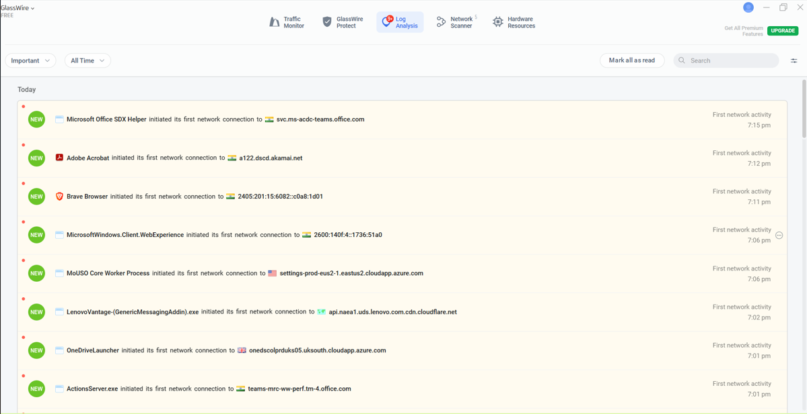
Experimentation & Results
Real-time alert showing first network activity detected by GlassWire
Log Analysis tab showing first-time network activity detection

Slide 8
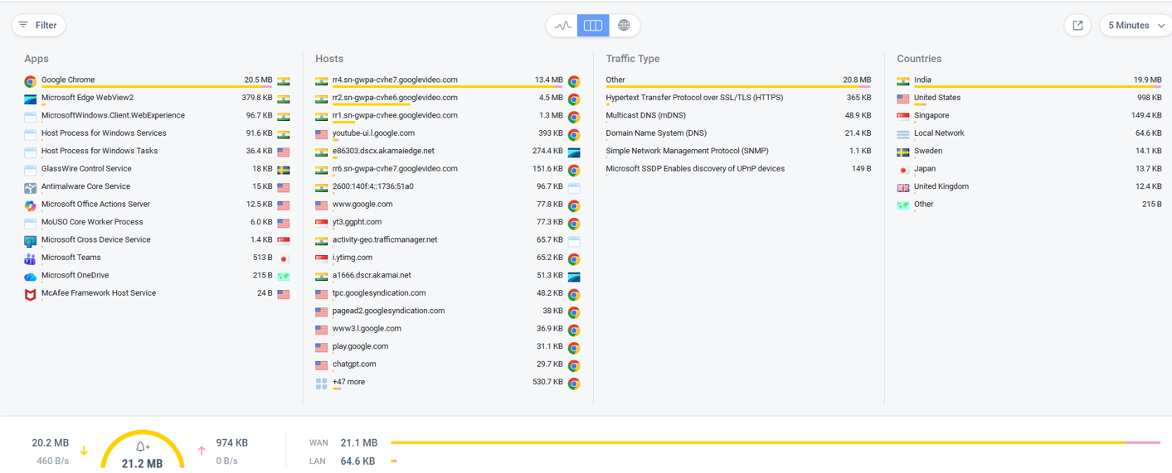
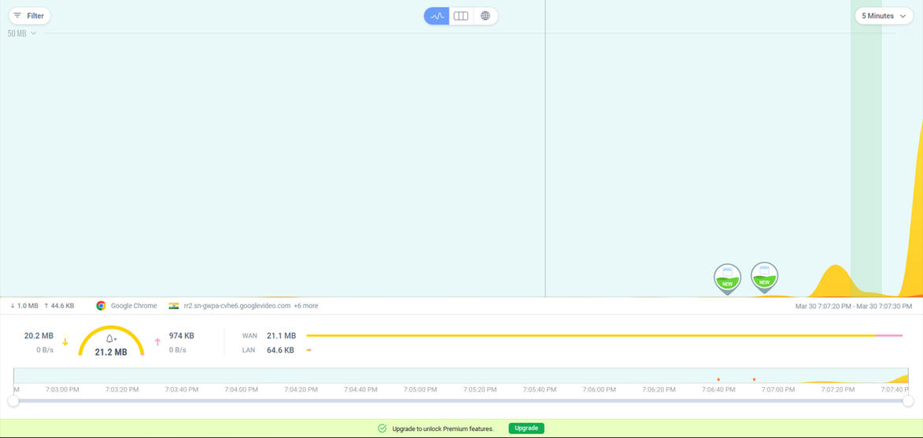
Host-level inspection showing remote server and associated application
Graphical network traffic visualization

Slide 9
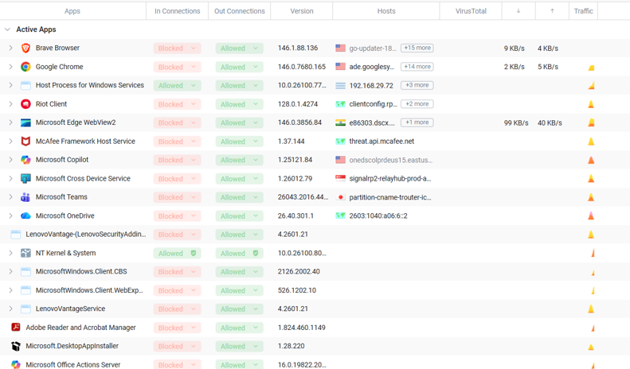
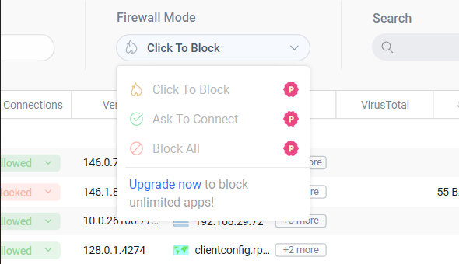
Google Chrome 103.7 MB
Country distribution
Traffic types
Detailed traffic session showing high bandwidth usage
Firewall

Slide 10
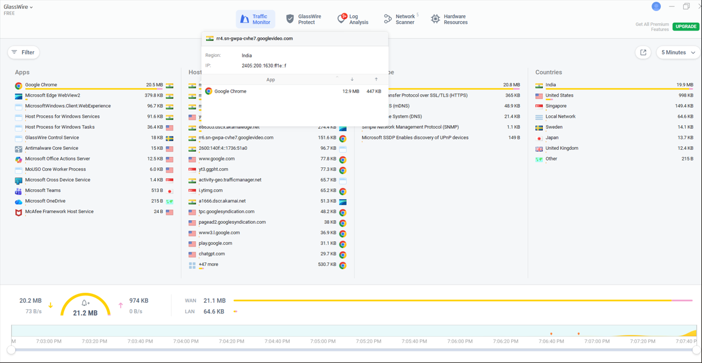
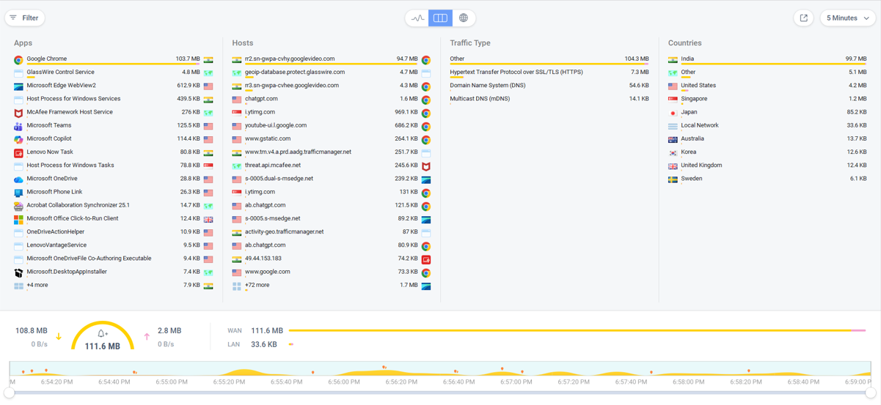
Real time usage
• Google Chrome highest bandwidth usage
• Multiple hosts contacted
Traffic Monitor showing application-wise and host-wise traffic
CPU
Memory
Disk
GPU
Hardware resource monitoring

Slide 11
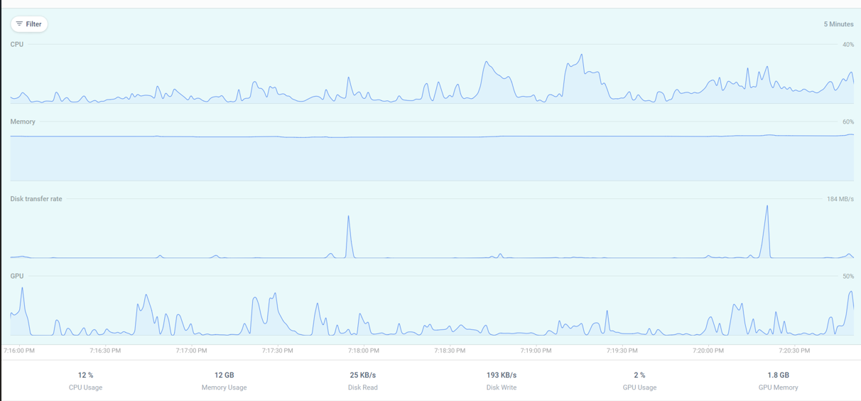
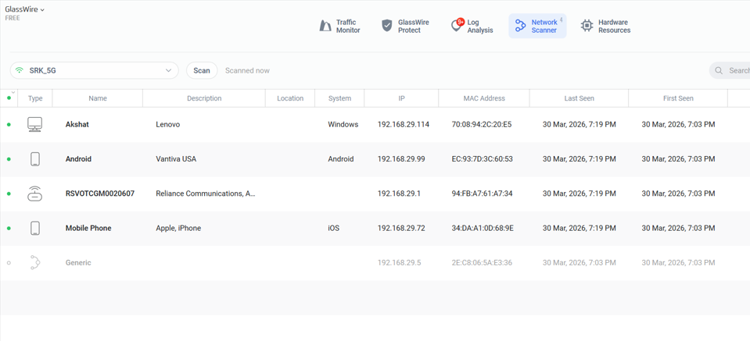
Shows:
Click to block
Ask to connect (Premium)
Firewall mode limitation in free version
Network scanner showing connected devices

Slide 12
Observed Results
Key Observations:
• Google Chrome highest bandwidth usage
• YouTube-related hosts detected
• Country-wise traffic displayed
• Multiple devices detected on network
• Real-time alerts generated
Analysis of Outcome
GlassWire successfully:
• Detected first-time network activity
• Monitored real-time traffic
• Identified high bandwidth apps
• Displayed host-level information
• Detected local network devices
• Provided hardware monitoring
GlassWire improves security visibility and monitoring.

Slide 13
Conclusion
The experiment successfully demonstrated GlassWire as an effective network monitoring and security analysis tool. It provided clear visibility into system network behavior, application activity, and connected devices, helping improve overall security awareness.
Key outcomes of the experiment include:
• Real-time network traffic monitoring
• Application-wise bandwidth usage analysis
• Host and country-level traffic visibility
• Alerts for first-time network activity
• Detection of devices connected to local network
• Firewall connection monitoring
• Hardware resource monitoring
Google Chrome was observed as the highest bandwidth-consuming application, mainly due to browsing and video streaming activity. GlassWire also detected multiple applications initiating first-time network connections and identified several devices connected to the Wi-Fi network.
Overall, GlassWire proved to be a useful tool for network monitoring, application behavior analysis, and security awareness, making it suitable for educational demonstrations and Network Information Security analysis.

